Slide 1

Automatic Street Light System
An energy-efficient solution for street lighting based on ambient light levels

Slide 2

Introduction
Street lighting is essential for safety and visibility at night, but conventional systems often waste energy due to manual controls.
This project aims to design an automatic street light system using electronic components that automatically control lighting based on ambient light levels.
The goal is to reduce energy consumption by turning lights on when it gets dark and off when daylight returns.

Slide 3

Apparatus Used
Light Dependent Resistor (LDR)
Resistors
BC547 Transistor
LED (Light Emitting Diode)
Power Supply (9V Battery or Adapter)

Slide 4

Procedure
Connect the LDR in a voltage divider configuration with a fixed resistor.
Connect the base of the BC547 transistor to the junction of the LDR and resistor.
Connect the emitter of the transistor to ground.
Connect the collector of the transistor to one terminal of the LED, and the other terminal to the positive supply.
Add a current-limiting resistor in series with the LED.
Test the circuit in varying light conditions to check if the street light turns on and off as expected.

Slide 5
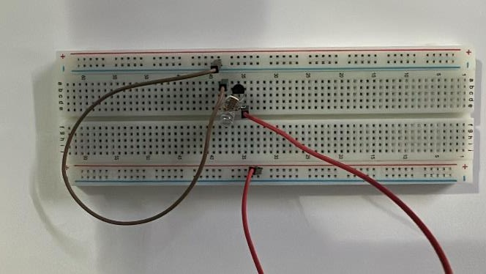
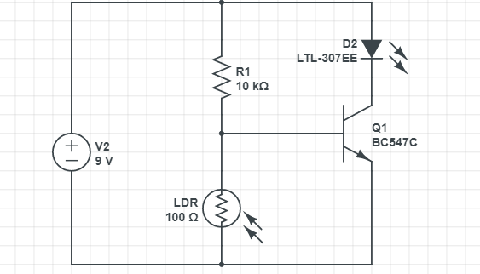
Circuit Diagram and Functionality Slide
The LDR controls the voltage at the base of the BC547 transistor. In low light, the transistor turns on, allowing current to flow through the LED. In bright light, the transistor remains off, and the LED stays off.

Slide 6

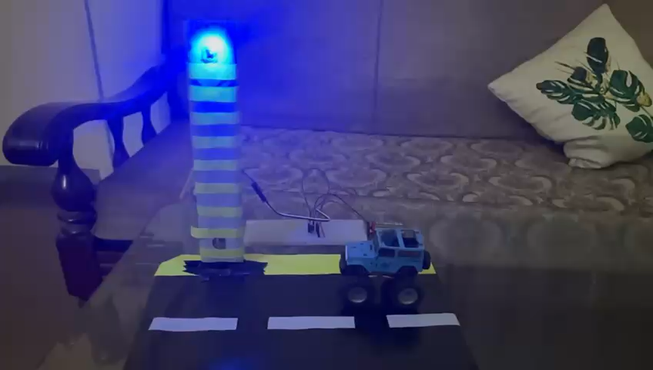
Demo Video

Slide 7
Linkedin + Github Shaban: https://github.com/myUserzEveryWhere/AP-project https://www.linkedin.com/in/shaban-ahmad-a87b112ba

Slide 8
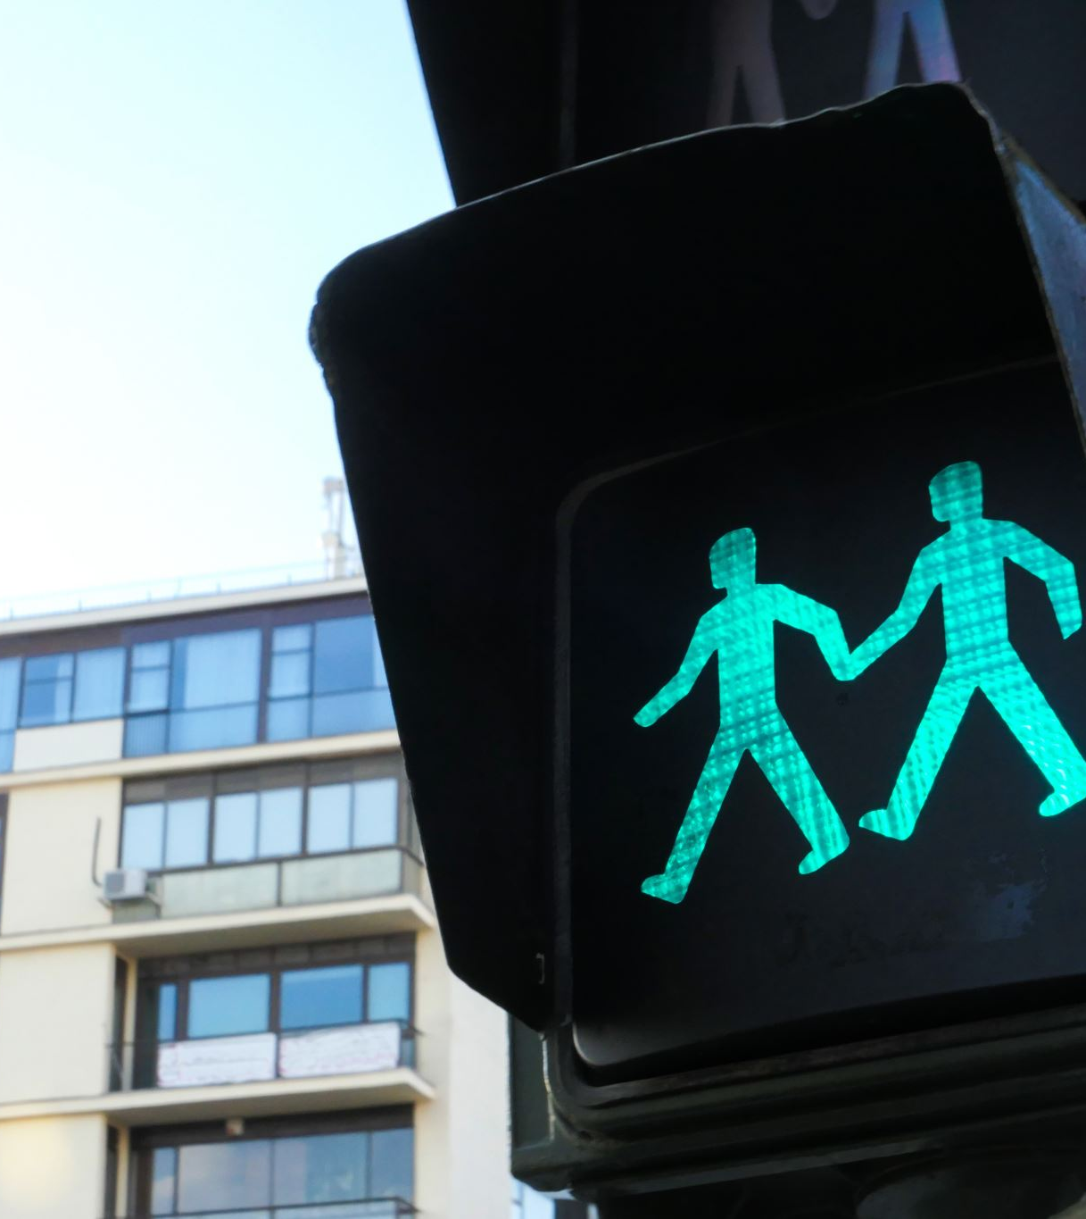
Conclusion
The automatic street light system efficiently controls street lights based on ambient light levels, ensuring energy efficiency by automatically turning lights on and off.
This system reduces energy wastage, improves safety, and can be further enhanced with solar integration and smart control features.

